Slide 1

XJTU
Li Yuxuan - Xi'an Jiaotong University
The Analysis and Visualization of Network Security Assessment Data
2024.4.18

Slide 2
1. Research Background
2. Related Technologies
CONTENT
3. Attack Detection and Visualization
4. Conclusion

Slide 3


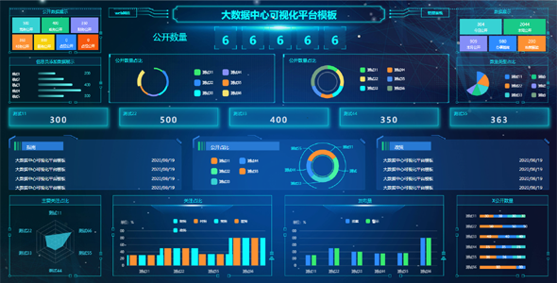
1. Research Background
Background
With the widespread application of internet technology, cybersecurity issues have become increasingly prominent. The diversification of cyber-attacks poses threats to national and public interests.
Cybersecurity visualization technology
About this research
the relevant theories and technologies of cybersecurity visualization systems
contributing to the improvement of cybersecurity defense levels
and the protection of national and public interests
complex network data
graphical manner
identifying abnormal behaviors and potential attack patterns
enhancing the accuracy and efficiency of network anomaly detection
reducing false positives and false negatives
strengthening cybersecurity defense capabilities
Notes:
To address this challenge, cybersecurity visualization technology has emerged.
By presenting complex network data in a graphical manner, it assists analysts in quickly identifying abnormal behaviors and potential attack patterns, enhancing the accuracy and efficiency of network anomaly detection, and reducing false positives and false negatives, thereby strengthening cybersecurity defense capabilities. This research aims to explore the relevant theories and technologies of cybersecurity visualization systems, with the expectation of contributing to the improvement of cybersecurity defense levels and the protection of national and public interests.

Slide 4
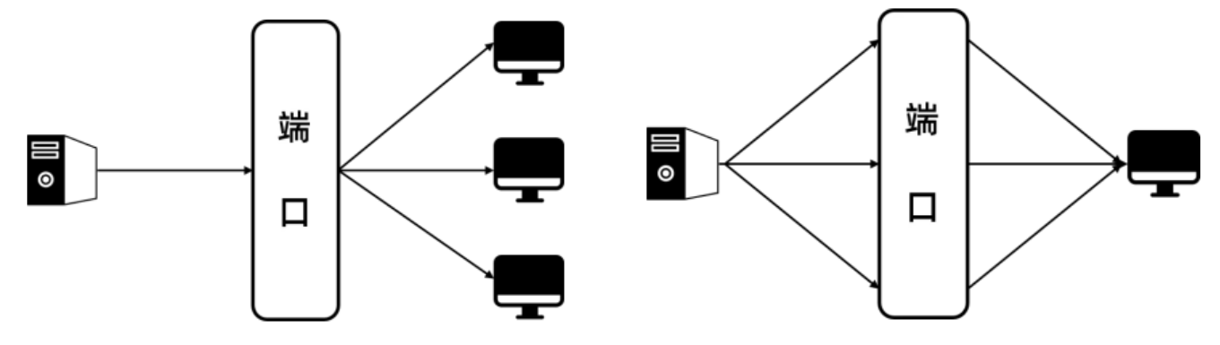
2. Related Technologies
Common Attack Methods
Port Scan (PortScan)
A common network detect technique where attackers use port scanning tools to understand the services and security vulnerabilities of the target system.
By analyzing the feedback, port scanning can reveal the characteristics and vulnerability information of the target system.
Denial of Service (DoS & DDoS)
A DoS attack involves the attacker using a flood of connections to increase the target system's load, causing it to be unable to provide services normally.
This type of attack consumes the target system's resources, preventing it from processing legitimate requests.
Brute Force Password Cracking (BruteForce)
A brute force attack involves an attacker attempting to gain access to a system or service by repeatedly trying different password combinations.
Attackers use automated software to execute a large number of password attempts, typically targeting weak username and password combinations.
Port
Port

Slide 5
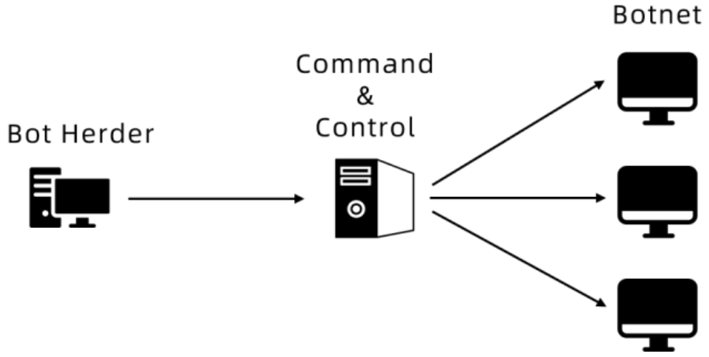
2. Related Technologies
Common Attack Methods
Web Attack (Web Attack)
Web-based attacks are methods that exploit browsers to compromise computer systems.
Attackers often start from legitimate but vulnerable websites and attempt to inject malware into users' systems by exploiting vulnerabilities in the browser.
Botnet (Botnet)
A botnet refers to a network that uses compromised computers to launch attacks or abuse online services. A botnet consists of multiple zombie computers, a command and control (C&C) server, and zombie hosts.

Slide 6

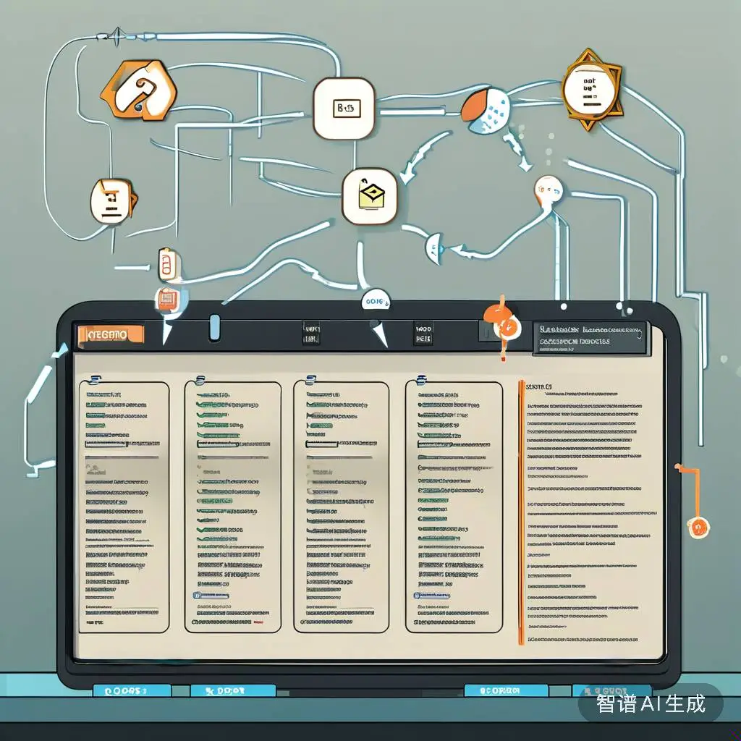
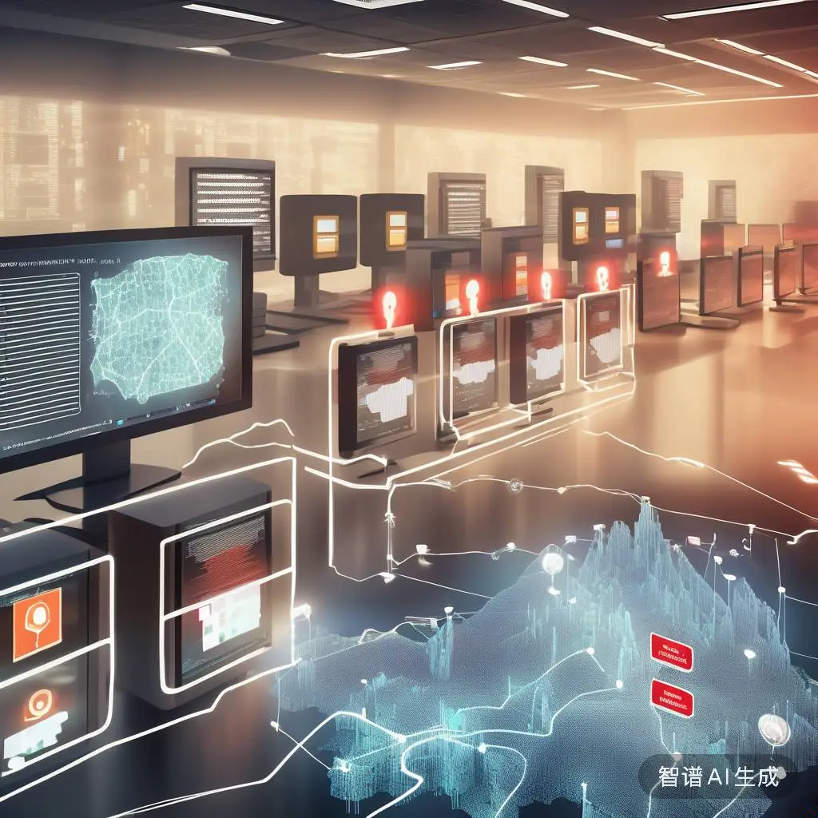
2. Related Technologies
Security Assessment Technologies
Statistical Anomaly Detection
Uses statistical methods to create profiles of normal behavior for objects such as network traffic or host activities. When new events or objects are detected, they are compared against these profiles to determine the degree of anomaly, which can indicate potential intrusions.
Rule-Based Anomaly Detection
Involves matching collected data against a set of predefined rules to detect specific malicious behaviors or attack patterns. These rules are crafted by security experts based on known attack signatures and vulnerabilities.
Machine Learning-Based Anomaly Detection
Utilizes machine learning algorithms to classify traffic into malicious and normal categories. It focuses on data processing and application, improving performance over time through pretraining and model weight updates.

Slide 7
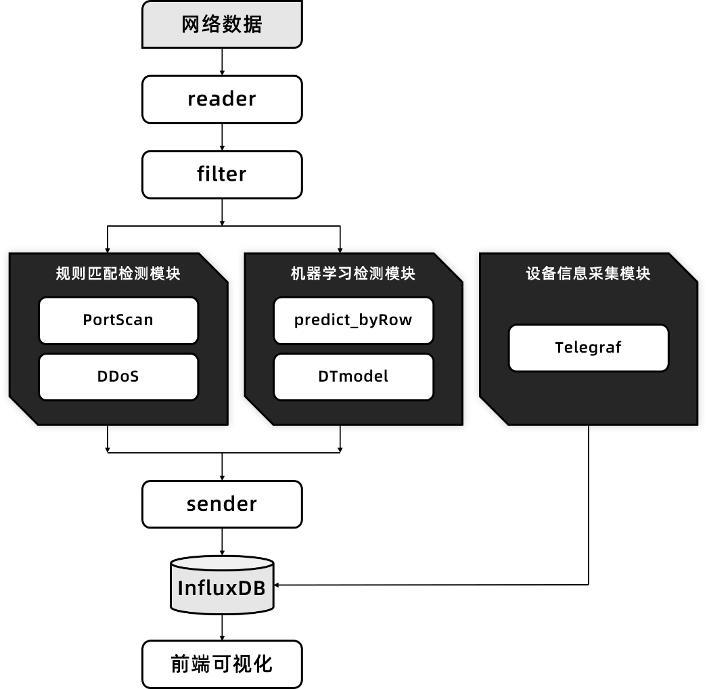
3. Attack Detection and Visualization
System Architecture
network data
Rule-Based Anomaly Detection
Machine Learning-Based Anomaly Detection
Device Information Collection
Visualization

Slide 8
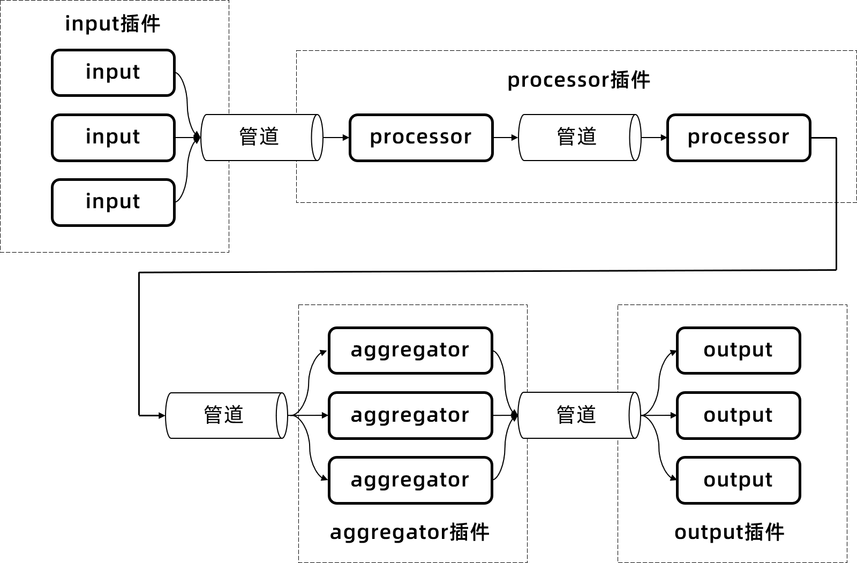
3. Attack Detection and Visualization
Dataset and Visualization tech
CIC-IDS2017
CICIDS2017 is a widely used dataset for network intrusion detection that is utilized to assess and study the performance of intrusion detection systems. This dataset includes both normal behavior and 14 types of typical intrusive network data streams, conforming to real-world network scenarios.
Visualization tech
Telegraf is a plugin-driven server agent designed to collect and report on a wide variety of metrics. It is capable of integrating directly with containers and systems to extract metrics, events, and log data.
InfluxDB is an open-source distributed time series database written in Go. It is specifically designed for efficient storage and time series data.
Grafana is an open-source platform for data visualization and monitoring that is used to display and analyze data in real time.
Pipeline
Pipeline
Pipeline
Pipeline

Slide 9

3. Attack Detection and Visualization
Data Preprocessing
Data Cleaning
Label Encoding
Category | Total lines | Proportions
BENIGN | 36474 | 35.8%
DoS Hulk | 30124 | 29.5%
DoS goldeneye | 10293 | 10.1%
FTP-Patator | 7935 | 7.8%
SSH-Patator | 5897 | 5.8%
DoS slowloris | 5796 | 5.7%
DoS Slowhttptest | 5499 | 5.4%
Data type | Numerical Labels
BENIGN | 0
DoS slowloris | 1
DoS Slowhttptest | 2
DoS Hulk | 3
DoS goldeneye | 4
FTP-Patator | 5
SSH-Patator | 6
Labels and Proportions of Each Attack Category
Numerical Labels After Encoding
Feature Selection
Feature Importance Ranking

Slide 10
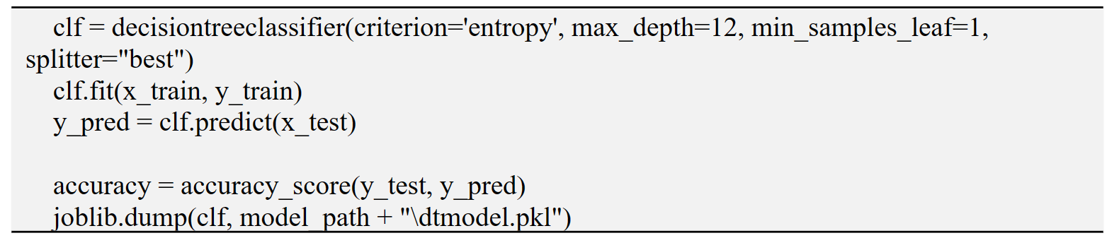
3. Attack Detection and Visualization
Model Training
Parameter | Value
criterion | entropy
max_depth | 12
min_samples_leaf | 1
splitter | best
Decision Tree Classifier Model Parameter Settings
Decision Tree Model Training

Slide 11
3. Attack Detection and Visualization
Model Data Prediction
First reads the data to be predicted, selects the list of features, and the model file. Then, for each row of the prediction data, the following steps are taken:
(1) Discard columns 0, 1, 2, 3, 5, and 6, as this part of the data is not suitable for machine learning and is therefore not included in the model's training data;
(2) Based on the list of selected features generated in the previous section, choose the feature columns required for prediction and input them into the model for prediction;
(3) Obtain the label results in One-Hot encoded form, and convert this result back to the original attack label type string;
(4) Combine the original data row with the predicted label string.
Finally, all prediction results are uniformly output as predicted.csv for subsequent database visualization.

Slide 12
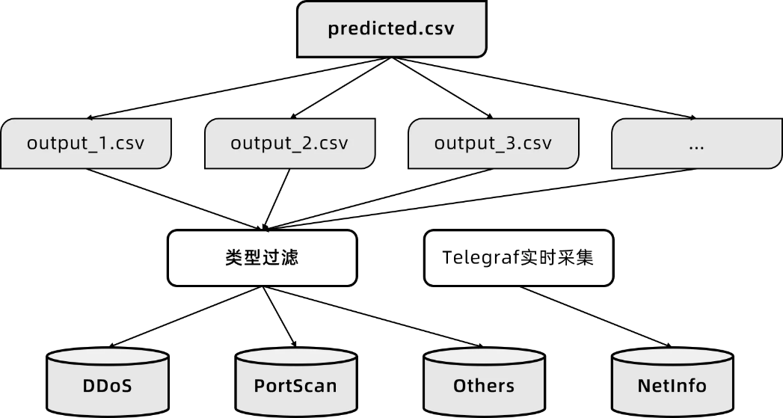
3. Attack Detection and Visualization
Data Importing into Database
Type Filtering
Telegraf

Slide 13
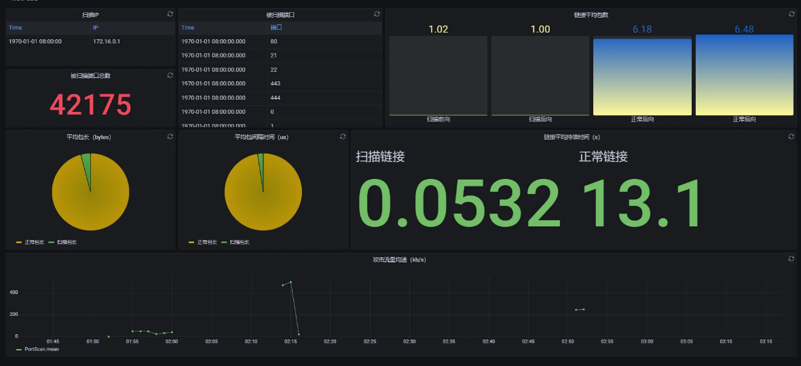
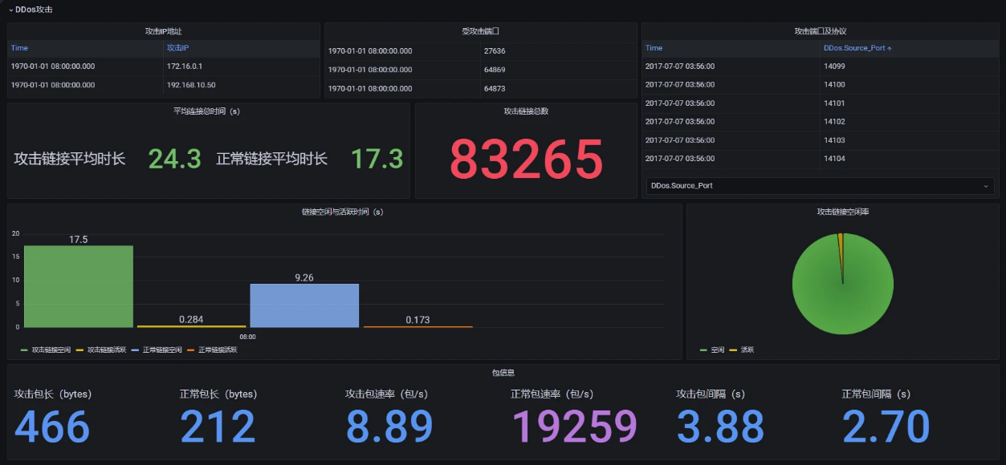
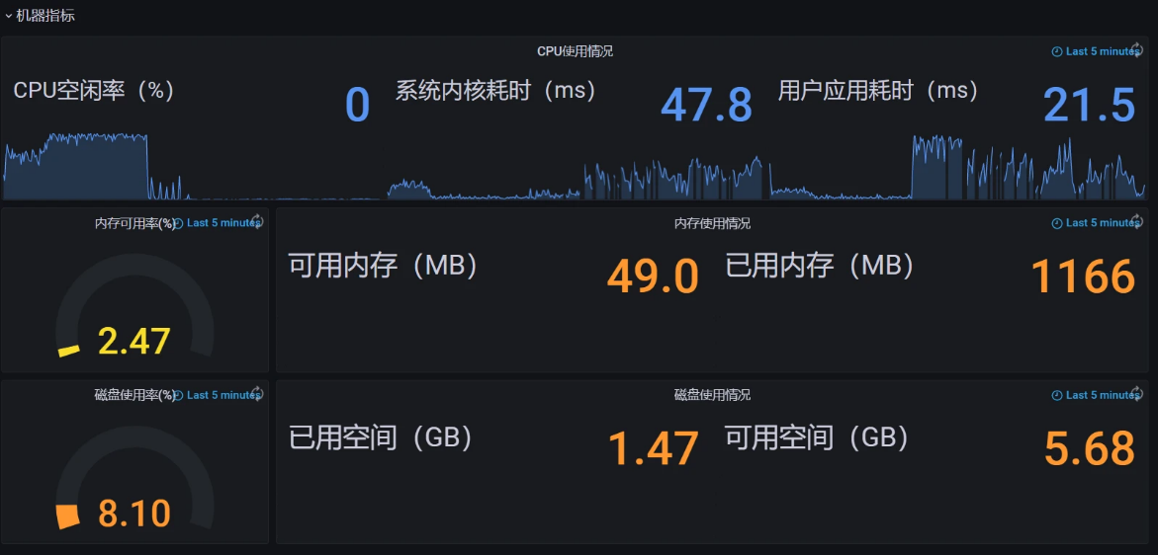
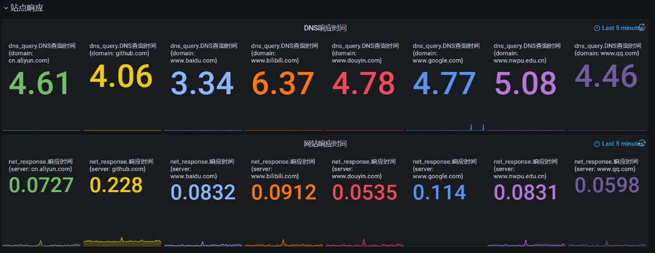
3. Attack Detection and Visualization
Visualization
PortScan
DDoS
Device Metrics
Site Response

Slide 14
4. Conclusion
Completed Work
The system uses the Telegraf + InfluxDB + Grafana stack to build a data visualization platform. This is a relatively mature approach, with each component having a rich ecosystem and excellent practicality.
The system is a network security assessment and visualization system that combines machine learning and rule matching to determine the nature of network traffic through a series of methods, ultimately presenting the results in a visualized form.
Future Prospects
Currently, the system is a prediction system based on a fixed dataset, and real-time network traffic information prediction for the real world has not yet been realized.
Moreover, the rule-based prediction method is relatively simple and cannot cope with real complex data situations. The machine learning method using decision trees also has significant limitations, such as the risk of overfitting, which can lead to a decline in generalization performance on new data.
To address these issues, more mature technical solutions will be adopted in the future to implement real-time network traffic security assessment and early warning. It is also possible to employ deep learning methods, such as neural networks, to learn from the data and ensure the accuracy of predictions for new and real-world data.

Slide 15
XJTU
The Analysis and Visualization of Network Security Assessment Data
Thanks for listening!
2024.4.18

